Slide 1



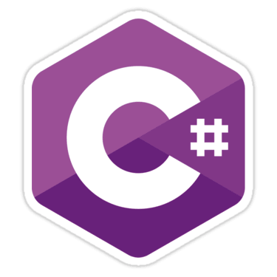



Language Comparison
Java, C#, PHP and JS
SoftUni Team
Technical Trainers
Software University
http://softuni.bg

Slide 2


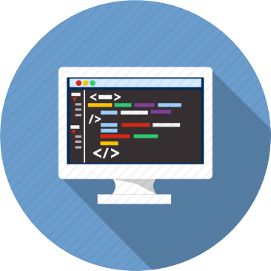
Table of Contents
IDE
Data Types
Variables
Printing on the Console
Reading from the Console
Loops
Methods

Slide 3
Table of Contents (2)
Arrays
Lists
Associative Arrays
Foreach Loop
Objects and Classes
Functional Programming
String Operations
RegEx

Slide 4




IDE
Overview

Slide 5
C#
Visual Studio 2017 Community

Slide 6
Java
IntelliJ IDEA

Slide 7
JavaScript
WebStorm

Slide 8
PHP
PhpStorm

Slide 9
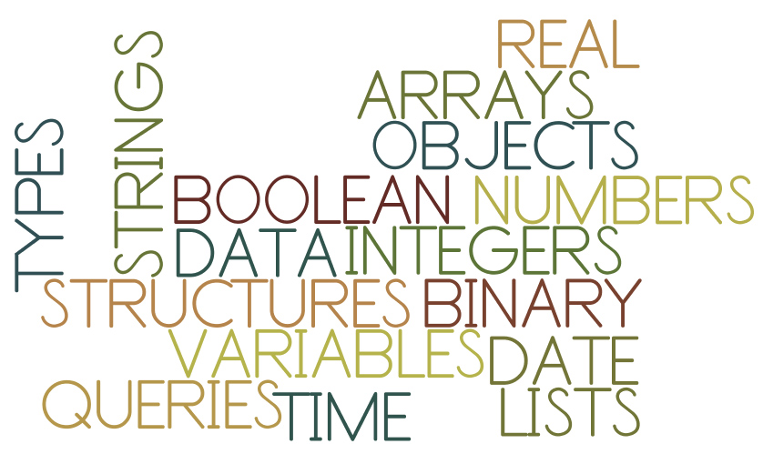
Data Types
Overview

Slide 10
C#
Floating point – double, decimal
Integer – int, long
Text – string, char
Boolean – bool
Other – null

Slide 11
Java
Floating point – double
Integer – int, long
Text – String, char
Boolean – boolean
Other – null

Slide 12
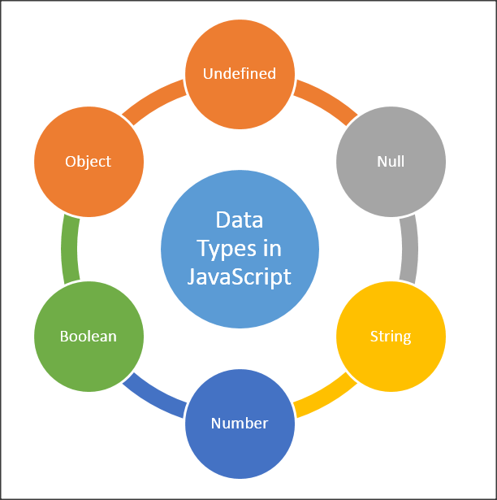
JavaScript
In JavaScript you are not declaring data types. The interpreter does it for you. There are the following data types:
number, string, boolean
object
function
null
undefined

Slide 13

PHP
In PHP you are not declaring data types. The interpreter does it for you. There are the following data types:
Integer
String
Float (Double)
Boolean
Object
NULL

Slide 14
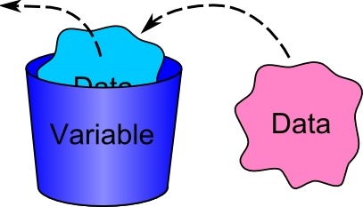
Declaring Variables
Overview

Slide 15
C#
To declare variable in C# you need to use the pattern:
Examples:
{data type} {variable name} = {value};
int firstNumber = 5;
string name = "Pesho";
bool isPassed = false;
char gender = 'F';
double mathGrade = 5.49;

Slide 16
Java
To declare variable in Java you need to use the pattern:
Examples:
{data type} {variable name} = {value};
int firstNumber = 5;
String name = "Pesho";
boolean isPassed = false;
char gender = 'F';
double mathGrade = 5.49;

Slide 17
JavaScript
To declare variable in JS you need to use the pattern:
Examples:
let {variable name} = {value};
let firstNumber = 5;
let name = "Pesho";
let isPassed = false;
let mathGrade = 5.49;

Slide 18
PHP
To declare variable in PHP you need to use the pattern:
Examples:
${variable name} = {value};
$firstNumber = 5;
$name = "Pesho";
$isPassed = false;
$mathGrade = 5.49;

Slide 19

Printing on the Console
Overview

Slide 20
C#
Printing your desired content and new line:
Or without new line:
string name = "Pesho";
Console.WriteLine(name);
string name = "Pesho";
Console.Write(name);

Slide 21
Java
Printing your desired content and new line:
Or without new line:
String name = "Pesho";
System.out.println(name);
String name = "Pesho";
System.out.print(name);

Slide 22
JavaScript
Printing your desired content and new line:
In JS you cannot print on the console without new line
let name = "Pesho";
console.log(name);

Slide 23
PHP
Printing your desired content and new line:
Or without new line:
$name = "Pesho";
echo $name . PHP_EOL;
$name = "Pesho";
echo $name;

Slide 24

Reading from the Console
Overview

Slide 25
C#
Reading string from the console:
Parsing string to int:
string age = Console.ReadLine();
string strAge = Console.ReadLine();
int age = int.Parse(strAge);

Slide 26
Java
Reading string from the console:
Parsing string to int:
Scanner console = new Scanner(System.in);
String age = console.nextLine();
Scanner console = new Scanner(System.in);
String ageStr = console.nextLine();
int age = Integer.parseInt(ageStr);

Slide 27
JavaScript
Reading string from the console and parsing it:
You will most likely never use console input for JavaScript apps.
let stdin = process.openStdin();
stdin.addListener("data", function(d) {
let ageStr = d.toString().trim();
let age = parseInt(ageStr);
console.log(name);
});

Slide 28
PHP
Reading string from the console and parsing it:
You will most likely never use console input for PHP apps.
$ageStr = trim(fgets(STDIN));
$age = intval($ageStr);

Slide 29

Loops
Overview

Slide 30
C#
Printing the numbers from 1 to 5:
Using while Loop
for (int i = 1; i <= 5; i++)
{
Console.WriteLine(i);
}
int i = 1;
while (i <= 5)
{
Console.WriteLine(i); i++;
}

Slide 31
Java
Printing the numbers from 1 to 5:
Using while Loop
for (int i = 1; i <= 5; i++) {
System.out.println(i);
}
int i = 1;
while (i <= 5) {
System.out.println(i); i++;
}

Slide 32
JavaScript
Printing the numbers from 1 to 5:
Using while Loop
for (let i = 1; i <= 5; i++) {
console.log(i);
}
let i = 1;
while (i <= 5) {
console.log(i); i++;
}

Slide 33
PHP
Printing the numbers from 1 to 5:
Using while Loop
for ($i = 1; $i <= 5; $i++) {
echo $i . PHP_EOL;
}
$i = 1;
while ($i <= 5){
echo $i . PHP_EOL; $i++;
}

Slide 34
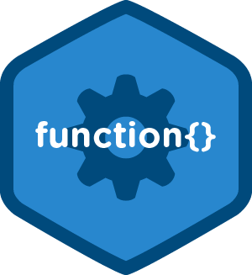
Methods/Functions
Overview

Slide 35
C#
To create a method in C# you need to use the pattern:
Example:
public {type} {name}({type} {argument}, …) { body }
public double CalcAverage(int x, int y)
{
double avg = (x + y) / 2.0;
return avg;
}

Slide 36
Java
To create a method in Java you need to use the pattern:
Example:
public {type} {name}({type} {argument}, …) { body }
public double calcAverage(int x, int y) {
double avg = (x + y) / 2.0;
return avg;
}

Slide 37
JavaScript
To create a method in JS you need to use the pattern:
Example:
function {name}({argument}, …) { body }
function calcAverage(x, y) {
let avg = (x + y) / 2.0;
return avg;
}

Slide 38
PHP
To create a method in PHP you need to use the pattern:
Example:
function {name}({type}{argument}, …):{return type} { body }
function calcAverage(float $x, float $y) : float
{
$avg = ($x + $y) / 2.0;
return $avg;
}

Slide 39
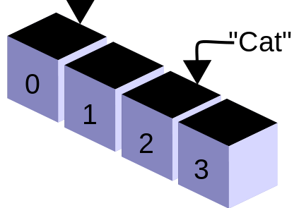
Arrays
Overview

Slide 40
C#
To declare an array you need to use the pattern:
Examples:
{type}[] {name} = new {type}[{count of elements}];
int[] firstNumber = new int[5];
string[] names = new string[3];

Slide 41
Java
To declare an array you need to use the pattern:
Examples:
{type}[] {name} = new {type}[{count of elements}];
int[] numbers = new int[5];
String[] names = new String[3];

Slide 42
JavaScript
To declare an array you need to use the pattern:
Examples:
let {name} = [];
let numbers = [0, 0, 0, 0, 0];
let names = ["Pesho", "Gosho", "Ivan"];

Slide 43
PHP
To declare an array you need to use the pattern:
Examples:
${name} = [];
$numbers = [0, 0, 0, 0, 0];
$names = ["Pesho", "Gosho", "Ivan"];

Slide 44

Lists
Overview

Slide 45
C#
To declare a list you need to use the pattern:
Adding element to a list:
List<{type}> {name} = new List<{type}>();
List<int> numbers = new List<int>();
numbers.Add(5);

Slide 46
Java
To declare a list you need to use the pattern:
Adding element to a list:
ArrayList<{class type}> {name} = new ArrayList<>();
ArrayList<Integer> numbers = new ArrayList<>();
numbers.add(5);

Slide 47
JavaScript
To declare a list you need to use the pattern:
Adding element to a list:
let {name} = [];
let numbers = [];
numbers.push(5);

Slide 48
PHP
To declare a list you need to use the pattern:
Adding element to a list:
${name} = [];
$numbers = [];
$numbers[] = 5;

Slide 49
Associative Arrays
ivan
gosho
pesho
0845-346-356
2350-452-167
1255-377-131
Overview

Slide 50
C#
To declare an associative array you need to use the pattern:
Adding element to a dictionary:
Dictionary<{type}, {type}> {name} = new Dictionary<{key type}, {value type}>();
Dictionary<string, int> peopleAge = new Dictionary<string, int>();
peopleAge.Add("Pesho", 20);
Console.WriteLine(peopleAge["Pesho"]);

Slide 51
Java
To declare an associative array you need to use the pattern:
Adding element to a dictionary:
LinkedHashMap<{type}, {type}> {name} =
new LinkedHashMap<>();
LinkedHashMap<String, Integer> peopleAge =
new LinkedHashMap<>();
peopleAge.put("Pesho", 20);
System.out.println(peopleAge.get("Pesho"));

Slide 52
JavaScript
To declare an associative array you need to use the pattern:
Adding element to a dictionary:
let {name} = new Map();
let peopleAge = new Map();
peopleAge.set("Pesho", 20);
console.log(peopleAge.get("Pesho"))

Slide 53
PHP
To declare an associative array you need to use the pattern:
Adding element to a dictionary:
${name} = [];
$peopleAge = [];
$peopleAge["Pesho"] = 20;
echo $peopleAge["Pesho"];

Slide 54
Foreach Loop
Overview

Slide 55
C#
Using foreach loop to iterate over list of integers:
List<int> numbers = new List<int> {1, 2, 3, 4, 5};
foreach (int number in numbers)
{
Console.WriteLine(number);
}

Slide 56
Java
Using foreach loop to iterate over list of integers:
List<Integer> numbers = Arrays.asList(1, 2, 3, 4, 5);
for(int number : numbers) {
System.out.println(number);
}

Slide 57
JavaScript
Using foreach loop to iterate over list of integers:
let numbers = [1, 2, 3, 4, 5];
for(number of numbers) {
console.log(number);
}

Slide 58
PHP
Using foreach loop to iterate over list of integers:
$numbers = [1, 2, 3, 4, 5];
foreach ($numbers as $number){
echo $number . PHP_EOL;
}

Slide 59

Objects and Classes
Overview

Slide 60
C#
To declare a class you need to use the pattern:
Class with one field:
public class { name } { body }
public class Person
{
public int age;
}

Slide 61
Java
To declare a class you need to use the pattern:
Class with one field:
public class { name } { body }
public class Person {
public int age;
}

Slide 62
JavaScript
To declare a class you need to use the pattern:
Class with one field:
class { name } { body }
class Person {
constructor(age) {
this.age = age;
}
}

Slide 63
PHP
To declare a class you need to use the pattern:
Class with one field:
class { name } { body }
class Person {
public $age;
}

Slide 64

Functional Programming
Overview

Slide 65
C#
Getting only the even numbers from a given collection:
int[] numbers = {1, 2, 3, 4, 5, 6};
numbers = numbers.Where(x => x % 2 == 0).ToArray();

Slide 66
Java
Getting only the even numbers from a given collection:
int[] numbers = {1, 2, 3, 4, 5, 6};
numbers = Arrays.stream(numbers)
.filter(x -> x % 2 == 0).toArray();

Slide 67
JavaScript
Getting only the even numbers from a given collection:
let numbers = [1, 2, 3, 4, 5, 6];
numbers = numbers.filter(x => x % 2 === 0);

Slide 68
PHP
Getting only the even numbers from a given collection:
$numbers = [1, 2, 3, 4, 5, 6];
$numbers = array_filter($numbers, function($x)
{
return $x % 2 === 0;
});

Slide 69
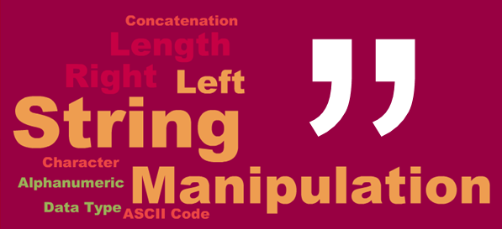
String Operations
Overview

Slide 70
C#
Replacing substring in a given string:
There are many more manipulation methods, such as:
IndexOf()
Substring()
Trim()
Contains()
string welcomeMsg = "Hello, name";
welcomeMsg = welcomeMsg.Replace("name", "user");

Slide 71
Java
Replacing substring in a given string:
There are many more manipulation methods, such as:
indexOf()
substring()
trim()
contains()
String welcomeMsg = "Hello, name";
welcomeMsg = welcomeMsg.replace("name", "user");

Slide 72
JavaScript
Replacing substring in a given string:
There are many more manipulation methods, such as:
indexOf()
substring()
trim()
includes()
let welcomeMsg = "Hello, name";
welcomeMsg = welcomeMsg.replace("name", "user");

Slide 73
PHP
Replacing substring in a given string:
There are many more manipulation methods, such as:
stripos()
substr()
trim()
strstr()
$welcomeMsg = "Hello, name";
$welcomeMsg = str_replace("name", "user", $welcomeMsg);

Slide 74

RegEx
Overview

Slide 75
C#
Getting everything that is not capital letter
string pattern = @"[^A-Z]";
string input = @"If you have Problems";
foreach (Match m in Regex.Matches(input, pattern))
{
Console.WriteLine(m.Value);
}

Slide 76
Java
Getting everything that is not capital letter
String pattern = "[^A-Z]";
String string = "If you have problems";
Pattern pattern = Pattern.compile(pattern);
Matcher matcher = pattern.matcher(string);
while (matcher.find()) {
System.out.println(matcher.group(0));
}

Slide 77
JavaScript
Getting everything that is not capital letter
let pattern = /[^A-Z]/g;
let str = `If you have Problems`;
let m;
while ((m = pattern.exec(str)) !== null) {
if (m.index === pattern.lastIndex) {
pattern.lastIndex++;
}
m.forEach((match, groupIndex) => {
console.log(match);
});
}

Slide 78
PHP
Getting everything that is not capital letter
$pattern = '/[^A-Z]/';
$str = 'If you have Problems';
preg_match_all($pattern, $str, $matches);
print_r($matches);

Slide 79







Language Comparison
https://softuni.bg/courses/

Slide 80

License
This course (slides, examples, demos, videos, homework, etc.) is licensed under the "Creative Commons Attribution-NonCommercial-ShareAlike 4.0 International" license
Attribution: this work may contain portions from
"Fundamentals of Computer Programming with C#" book by Svetlin Nakov & Co. under CC-BY-SA license
"C# Part I" course by Telerik Academy under CC-BY-NC-SA license
"C# Part II" course by Telerik Academy under CC-BY-NC-SA license

Slide 81





Trainings @ Software University (SoftUni)
Software University – High-Quality Education, Profession and Job for Software Developers
softuni.bg
Software University Foundation
http://softuni.foundation/
Software University @ Facebook
facebook.com/SoftwareUniversity
Software University Forums
forum.softuni.bg

